Slide 1


DATA SCIENCE
UNIT 4- Preprocessing of Data
Presented by:
Sachin Saxena
SME, upGrade

Slide 2
Imputation on categorical/numeric columns:
Categorical column:
Impute the most popular category.
Imputation can be done using logistic regression techniques.
Numerical column:
Impute the missing value with mean/median/mode.
The other methods to impute the missing values involve the use of interpolation, linear regression. These methods are useful for continuous numerical variables.

Slide 3
Handling Outliers
Outliers are values that are much beyond or far from the next nearest data points.

Slide 4
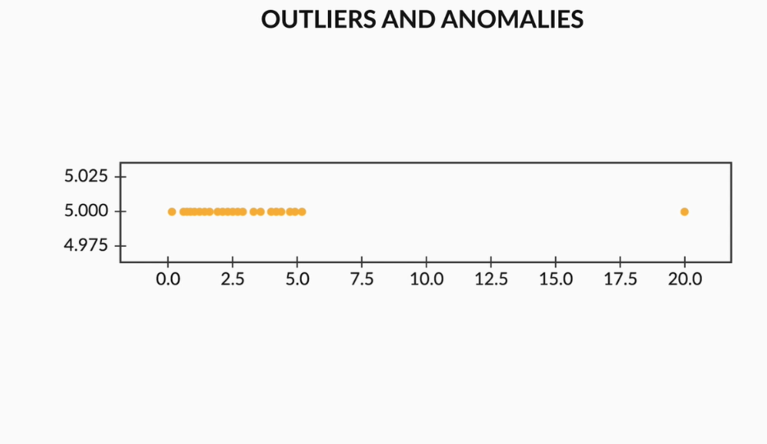
Types of Outliers:
Univariate outliers: Univariate outliers are those data points in a variable whose values lie beyond the range of expected values. You can get a better understanding of univariate outliers from the image below. Here, almost all the points lie between 0 and 5.0, and one point is extremely far away (at 20.0) from the normal norms of this data set.

Slide 5
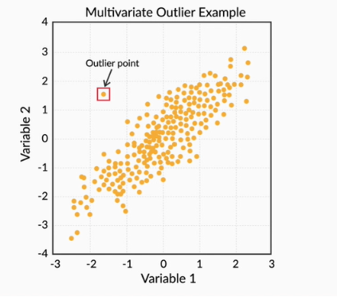
Multivariate outliers: While plotting data, some values of one variable may not lie beyond the expected range, but when you plot the data with some other variable, these values may lie far from the expected value. These are called multivariate outliers. You can refer to the image below to get a better understanding of multivariate outliers.

Slide 6
The major approaches to the treatment of outliers can include:
Imputation
Deletion of outliers
Binning of values
Capping the outliers
In the process of handling missing values and outliers of different columns, you are already performing univariate analysis. You will learn more about it in further sessions. In this video, you will learn how to implement all your learning on the bank marketing dataset.

Slide 7
Standardising Values:
Checklist for future data cleaning exercises:
Standardise units: Ensure all observations under one variable are expressed in a common and consistent unit, e.g., convert lbs to kg, miles/hr to km/hr, etc.
Scale values if required: Make sure all the observations under one variable have a common scale.
Standardise precision for a better presentation of data, e.g., change 4.5312341 kg to 4.53 kg.

Slide 8
Checklist for future data cleaning exercises:
Remove extra characters such as common prefixes/suffixes, leading/trailing/multiple spaces, etc. These are irrelevant to the analysis.
Standardise case: String variables may take various casing styles, e.g., FULLCAPS, lowercase, Title Case, Sentence case, etc.
Standardise format: It is important to standardise the format of other elements such as date, name, etc. For example, change 23/10/16 to 2016/10/23, “Modi, Narendra” to “Narendra Modi", etc.

Slide 9
Fixing Invalid Values and Filter Data:
Future data cleaning exercises:
Encode unicode properly: In case the data is being read as junk characters, try to change the encoding, for example, use CP1252 instead of UTF-8.
Convert incorrect data types: Change the incorrect data types to the correct data types for ease of analysis. For example, if numeric values are stored as strings, then it would not be possible to calculate metrics such as mean, median, etc. Some of the common data type corrections include changing a string to a number ("12,300" to “12300”), a string to a date ("2013-Aug" to “2013/08”), a number to a string (“PIN Code 110001” to "110001"), etc.
Correct the values that lie beyond the range: If some values lie beyond the logical range, for example, temperature less than -273° C (0° K), then you would need to correct those values as required. A close look at the data set would help you determine whether there is scope for correction or the value needs to be removed.

Slide 10
Fixing Invalid Values and Filter Data:
Future data cleaning exercises:
Correct the values not belonging in the list: Remove the values that do not belong to a list. For example, in a data set of blood groups of individuals, strings ‘E’ or ‘F’ are invalid values and can be removed.
Fix incorrect structure: Values that don’t follow a defined structure can be removed from a data set. For example, in a data set containing the pin codes of Indian cities, a pin code of 12 digits would be an invalid value and would need to be removed. Similarly, a phone number of 12 digits would be an invalid value.
Validate internal rules: Internal rules, if present, should be correct and consistent. For example, the date of a product’s delivery should definitely come after the date of purchase.

Slide 11
Fixing Invalid Values and Filter Data:
Deduplicate data: Remove identical rows and the rows in which some columns are identical.
Filter rows: Filter rows by segment and date period to obtain only rows relevant to the analysis.
Filter columns: Filter columns relevant to the analysis.
Aggregate data: Group by the required keys and aggregate the rest.

Slide 12
Case Study:
Dataset: 3_8 Attribute+DataSet.csv
Dataset: 3_9 3_9 Dress+Sales.csv
Python code: 3_10 EDA+Graded+Exercise.ipynb

Slide 13
Introduction to Univariate Analysis:
Exploratory Data Analysis (EDA) is to learn univariate analysis. It deals with analysing a single column/variable.
You will learn about univariate analysis, which broadly is of the following four types:
Categorical unordered univariate analysis
Categorical ordered univariate analysis
Statistics on the numerical variable
Numerical variable univariate analysis

Slide 14
Categorical Unordered Univariate Analysis
Univariate analysis involves the analysis of a single variable at a time. The concept of univariate analysis is divided into ordered and unordered category of variables. In this segment, you will learn how to conduct univariate analysis on categorical unordered variables.

Slide 15
Unordered data is the type of data that does not have any measurable terms (measurable terms can be like high-low, more-less, fail-pass, etc.) Example:
The type of loan taken by an individual (home loan, personal loan, auto loan, etc.) does not have any ordered notion. They are just different types of loans.
Departments of an organisation — Sales, Marketing, HR — are different departments in an organization, with no measurable attribute attached to any term.

Slide 16
Unordered variables also called Nominal variables.
An unordered variable, primarily, is a categorical variable that has no defined order. Let's consider the example of the job column in the Bank Marketing dataset. There, 'job' is divided into many sub-categories like technician, blue-collar, services, management, etc. There is no weight or measure given to any value in the 'job' column.

Slide 17
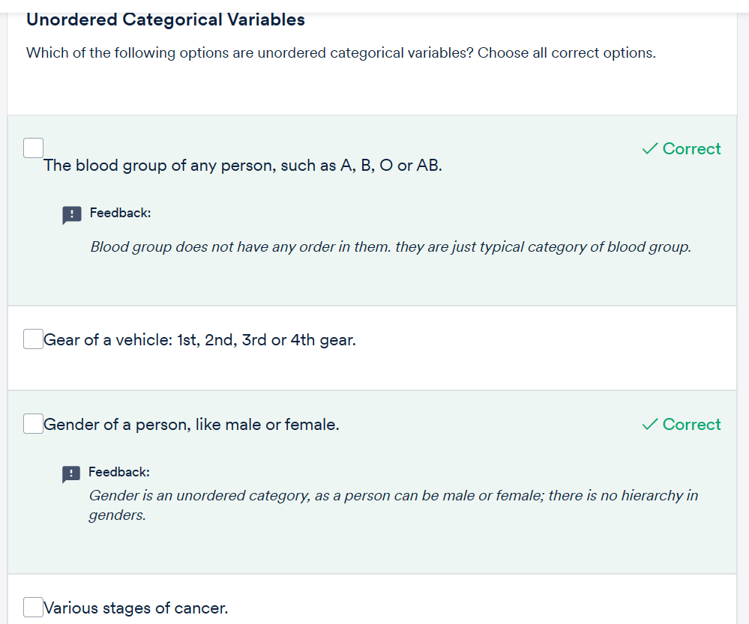
Question:

Slide 18
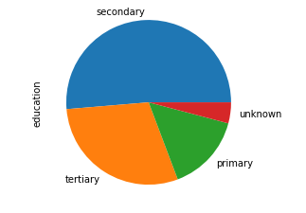
Categorical Ordered Univariate Analysis
Ordered variables are those variables that follow a natural rank of order. Some examples of categorical ordered variables from the Bank Marketing dataset are:
Age group: <30, 30-40, 40-50 and so on
Month: Jan, Feb, Mar, etc.
Education: primary, secondary and so on

Slide 19
Transition of a numerical variable into an ordered categorical variable
Let’s consider a very interesting example of your school life. Suppose you have a dataset containing the marks of all the students in the 'Science' subject, and you are one of the students in that group. These marks can be considered as categorical if you divide the total marks into different categories like High, Medium, Average, Below Average, Poor. From this analysis, you can determine your ranking in the class and also find out how many students got more marks than you and how far away your score is from the mean or the average score.

Slide 20
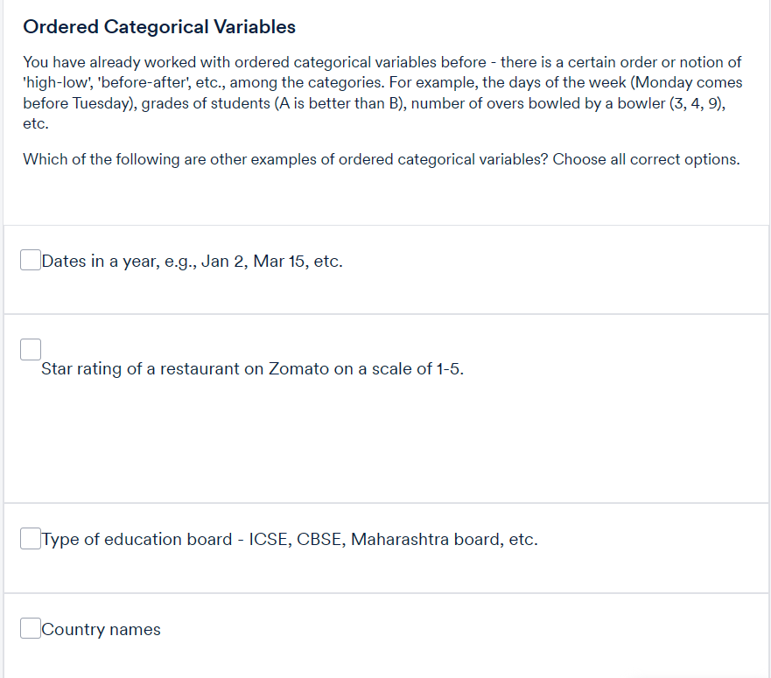
Question

Slide 21
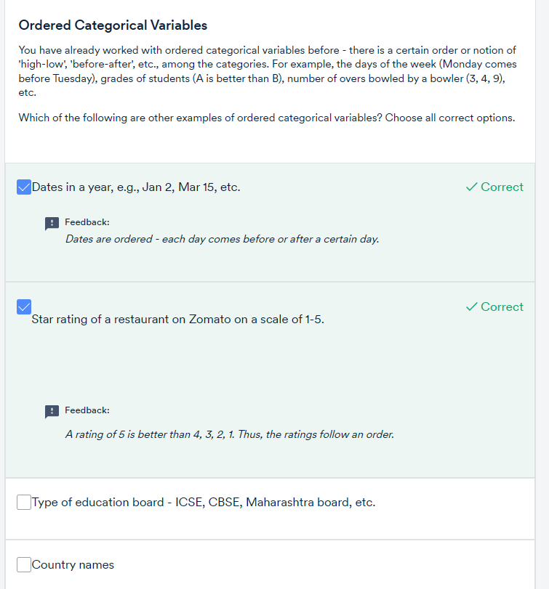
solution

Slide 22
Statistics on Numerical Features:
Numeric variables can be continuous like height, temperature, weight, etc. Numerical variables can also be discrete like the number of items bought by a customer in a store, the number of people in a city, the number of 'heads' you get when flipping three coins.

Slide 23
While 'mean' gives an average of all the values, the 'median' gives a typical value that can be used to represent the entire group. As a simple rule of thumb, always question someone if they use 'mean' since 'median' is primarily a better measure of ‘representativeness’.
Mean and median are single values that broadly give a representation of the entire data.

Slide 24
Standard deviation and interquartile difference are used to represent the spread of the data.
The interquartile difference is a much better metric than standard deviation if there are outliers in the data because the standard deviation will be influenced by outliers, while the interquartile difference will simply ignore them.

Slide 25
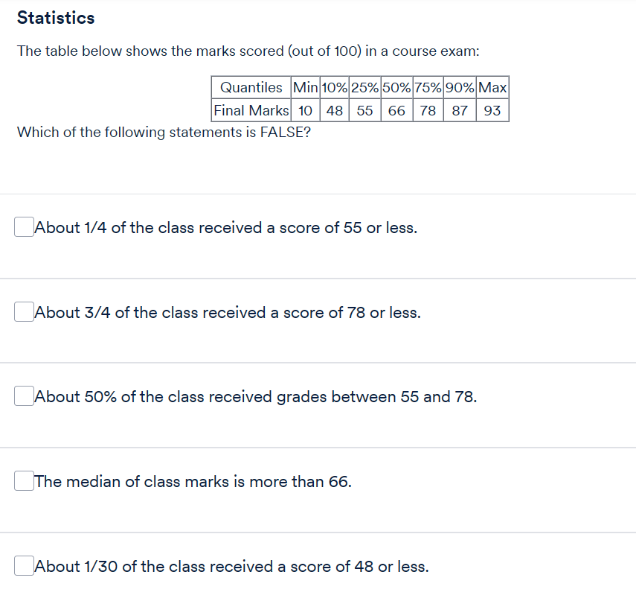
Question:

Slide 26
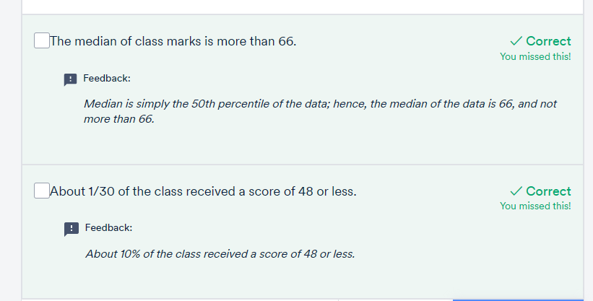
Solution:
Two options correct.

Slide 27
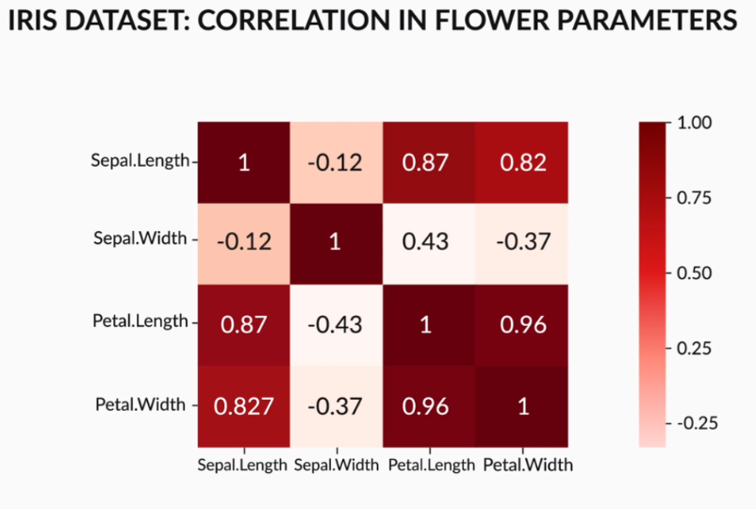
Numeric - Numeric Analysis:
how to analyse two numerical variables using the Bank marketing dataset. Now, there are multiple tools to analyse numerical variables.
Correlation matrix below, you can observe that petal length has a high correlation with sepal length, with a correlation coefficient of 0.87. Also, there is a very high correlation coefficient of 0.96 between petal width and petal length.

Slide 28
Correlation coefficient
depicts only a linear relationship between numerical variables. It does not depict any other relationship between variables. A zero correlation does not imply that there is no relation between variables; it merely indicates that there will no linear relationship between them. Also, there can be a negative or positive correlation between variables. A negative correlation means that if the value of one variable increases, the value of another decreases, whereas it is the opposite for a positive correlation.

Slide 29
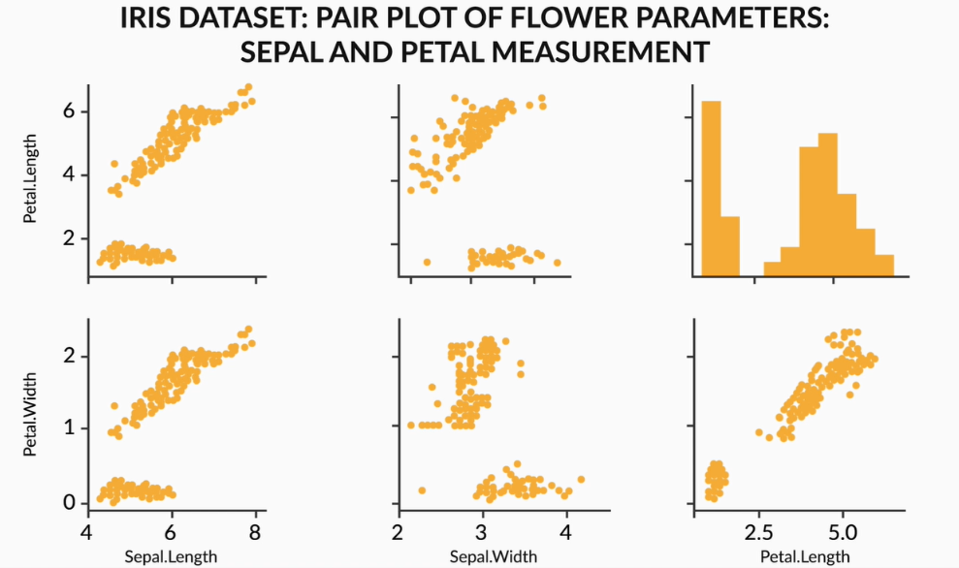

Slide 30
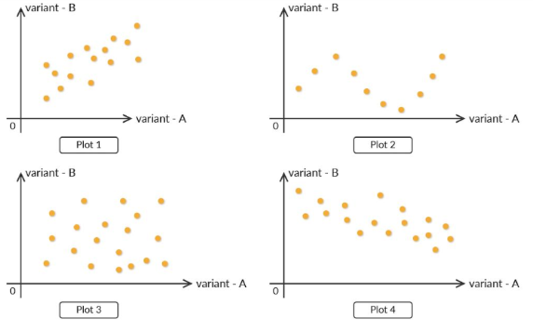
Out of the four plots, which has the least correlation coefficient?
A high correlation coefficient does not imply that there will be a correlation with another numeric variable every time because there can be no causation between them. There may be cases where you will see a high correlation coefficient between two variables but there is no relation between them. You will understand this in detail in the next segment that how correlation is related to the causation.

Slide 31
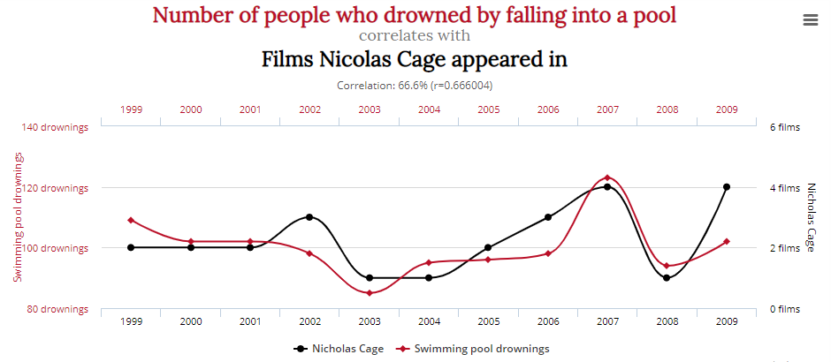
Correlation vs Causation:
Some numerical variables can sometimes be highly correlated to each other, there may not be a cause of any relationship between them. Explanation in next PPT:

Slide 32
The number of people who drowned by falling into a pool is not related to movies starring Nicolas Cage. However, if you observe the plot below, you will notice that there is a very high correlation between them, as both the plots follow almost the same path.

Slide 33
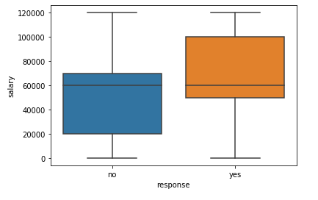
Numerical - Categorical Analysis
Previously, you learnt about the bivariate analysis of numerical variables. In this segment, you will learn about the associations between numerical and categorical variables. You will learn how to apply this analysis on the same bank marketing dataset.
a very different picture emerges when you plot a boxplot. The interquartile range for customers who gave a positive response is on the higher salary side. This is actually true, because people who have higher salaries are more likely to invest in term deposits.

Slide 34
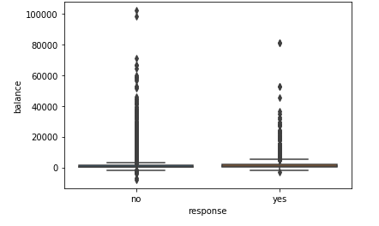
After the balance versus response graph is plotted, it does not make any sense at first glance. Sometimes only a boxplot is not sufficient to draw insights, because of a high concentration of data and or because of higher values in the data set, for example, the balance variable.
it is a good practice to analyse the data using mean, median or quartiles. In the section, you saw that the mean and median values of the balance variable are higher for customers who gave a positive response, which is again true, because people who have higher balance in their bank accounts are more likely to invest in term deposits.

Slide 35
Categorical - Categorical Analysis
In this segment, you will learn about the associations between two categorical variables in a bivariate analysis.
Statistical analysis is essential for numerical variables, and it includes different metrics like mean, median, mode, quantiles and boxplots. Here, you will learn how to analyse categorical variables using graphs and charts, and derive maximum insights from them.

Slide 36
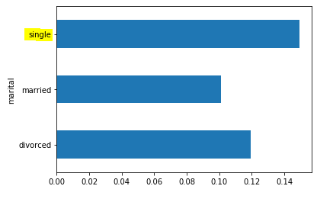
Based on marital status analysis, you can infer that single individuals have a higher positive response rate. This could be due to various reasons: One reason could be that compared with other categories of customers, single individuals have available income to deposit in long-term savings accounts (term deposit). Hence, the campaign should target single customers.

Slide 37
Multivariate Analysis
In this segment, we will discuss the next part of EDA, i.e., multivariate analysis.
So far, you have learnt how two variables can be visualised based on their type, for example, numerical, categorical, etc. Now, let’s analyse two variables simultaneously. One of the key features of multivariate analysis is that it gives you a very precise idea about the various elements, since you are now combining multiple variables to visualise the data set. You will learn about this in more detail in the forthcoming session.

Slide 38
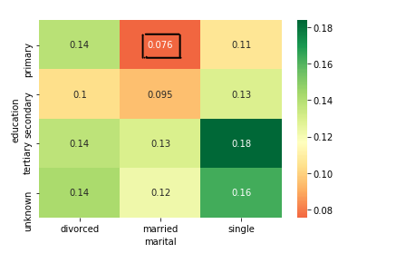
performed a three-variable analysis between education, marital status and response. You can see that people who are married and who have completed just their primary education are least likely to give a positive response on term deposits. This can be explained by the fact that people educated only up to the primary level are not aware of the benefits of term investments. Also, married individuals need money to fulfil their daily needs, and they require cash-on-hand to buy the daily essentials; hence, they won't prefer investing in term deposits.

Slide 39
Python code: 3_11 EDA+Graded+Exercise (1).ipynb

Slide 40
Summary
Analysis between two numerical variables: The most important thing to remember is that correlation and scatter plots are the best methods to perform an analysis on numerical variables. Correlation coefficient indicates how much two numerical variables are correlated linearly. And scatter plots offer the exact visualisation between the numerical variables.

Slide 41
Summary
Analysis between numerical and categorical variables: This gives an idea about the variation of a particular numerical variable with respect to different categories of a categorical variable. Boxplot is the best way to look at a numerical variable with respect to a categorical variable. However, boxplots may sometimes not be useful because of the huge difference between the maximum and minimum values in the data set, or due to the higher concentration of data in the numerical variable. Another approach could be to look into the mean/median or quartiles, which are a more efficient way to deal with a numerical variable when combined with a categorical variable. Take a look at the example shown below.

Slide 42
Summary
Correlation vs causation: This is a very important concept of data anaylsis, which states that correlation is not always related to causation. Although there may be a very high correlation between variables, there may be no causation at all.

Slide 43
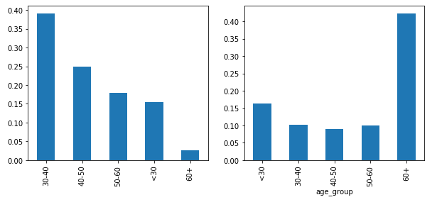
Summary
Analysis between two categorical variables: A bar graph is the best approach to analysing two categorical variables.

Slide 44
Python Code:
3_12 EDA_Notebook_Complete.ipynb

Slide 45
THANK YOU

